Slide 1

Grid Maze Pathfinding
Comparison
Noble Carpenter
Teagan Tobias
Christian Winchester
BFS
DFS
A*
ACO

Slide 2
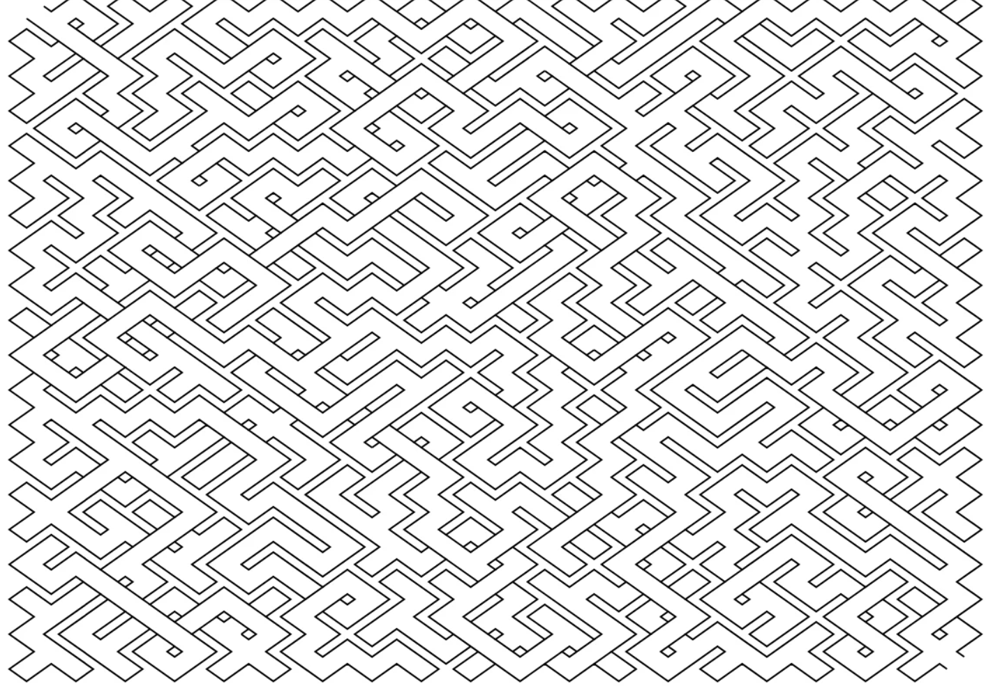
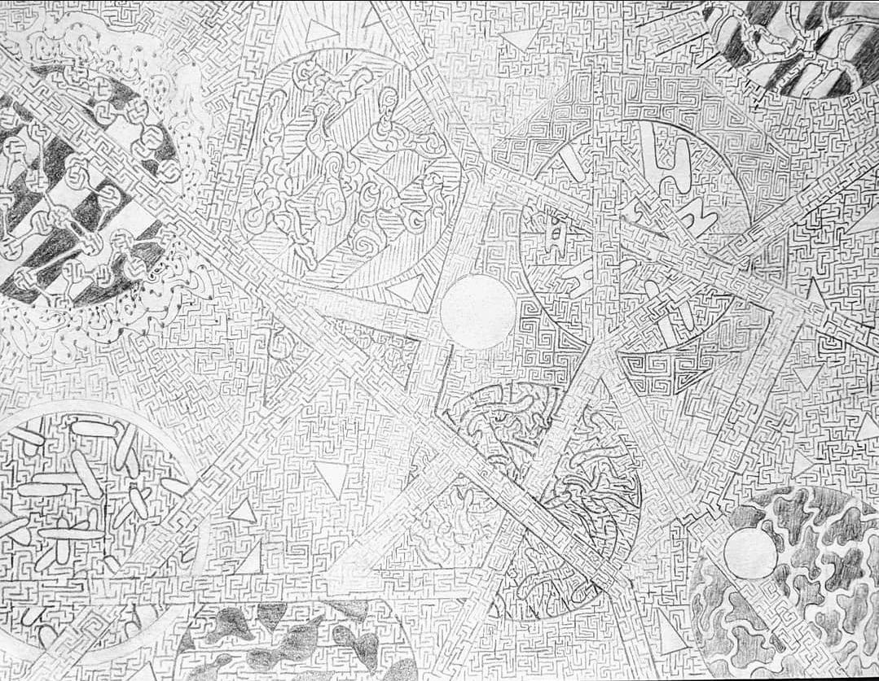
The Problem
Objective: Find the shortest path from start to finish in a 2D grid.
Constraints: Movement restricted to four cardinal directions.
Cost Model: Unweighted movement
Methodology: Comparative analysis of four algorithms
Evaluation Metrics: Runtime, memory usage, path optimality, and node expansion.

Slide 3
Breadth-First Search
Benchmark
first-in-first-out queue, visiting all nodes at distance k before k+1
•Always finds the optimal path
•Simple, deterministic baseline for comparison
•Memory-intensive due to large frontier sizes
Time Complexity: (V+E)
Space Complexity: (V)

Slide 4
DEPTH-FIRST SEARCH
Uses last-in-first-out stack, with randomized direction order for reproducibility
•Lower memory uses than BFS
•Often find a path quickly
•Does not guarantee shortest path; quality degrades with size
Time Complexity: (V+E), worst case
Space Complexity: (V), worst case

Slide 5
A* SEARCH
Uses a priority queue with f(n) = g(n) + h(n), where g(n) is path cost and h(n) is Manhattan distance.
•Optimal and usually faster than BFS
•Expands fewer nodes using heuristic guidance
•Performance drops as obstacles increase and heuristic becomes less informative
Time Complexity: (V+E), worst case
Space Complexity: (V)

Slide 6
ANT COLONY OPTIMIZATION
Nature inspired
Paths are built probabilistically using pheromone levels and heuristic distance
•Bio-inspired, does not rely on explicit graph traversal
•Stochastic and parameter-dependent
•No guarantee of optimality
Time Complexity: (iterations x ants x N2)(~constant factor ~1000 x BFS)
Space Complexity: (N2) for pheromone matrix

Slide 7
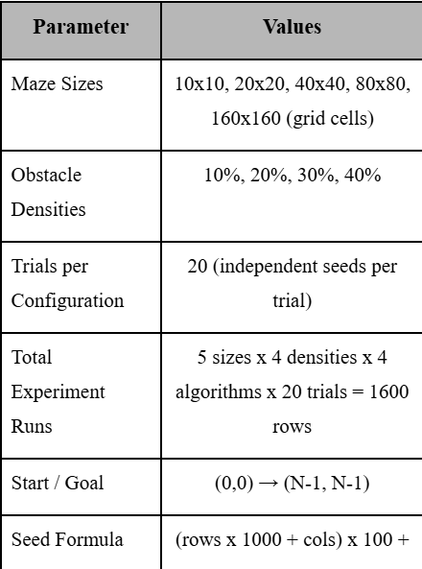
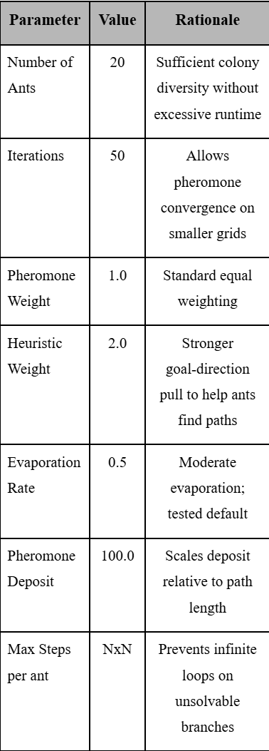
Input configuration
Implementations
Programming Language: Python 3.x
Reference Method: for optimality, BFS, which provides the true shortest path in unweighted grids, and all other algorithms were compared against it.
ACO Parameters

Slide 8
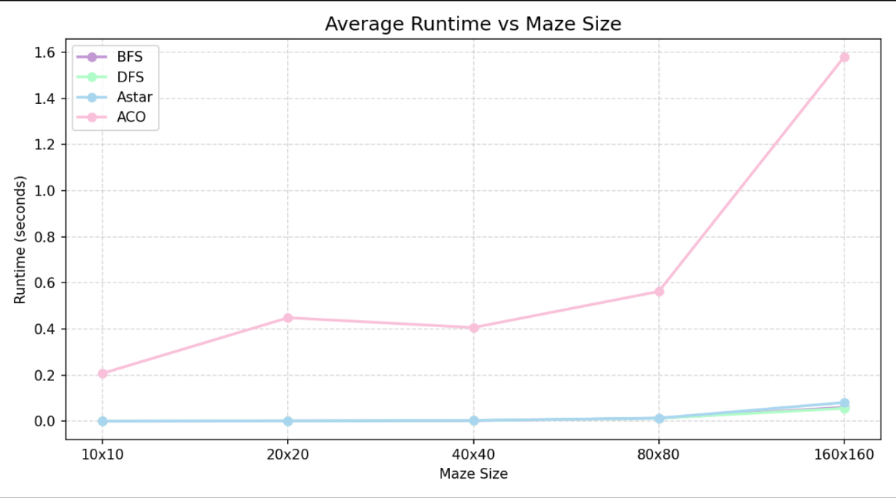
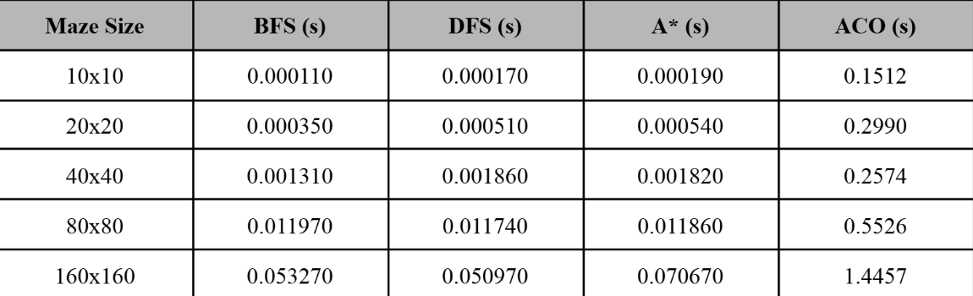
Execution Time vs Maze Size
As seen from both diagrams, the ant colony optimization runs quiteNumber System Venn Diagram slowly while everything else stays relatively equivalent

Slide 9
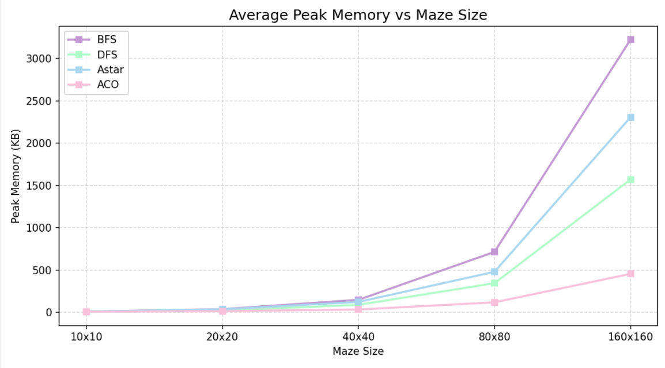
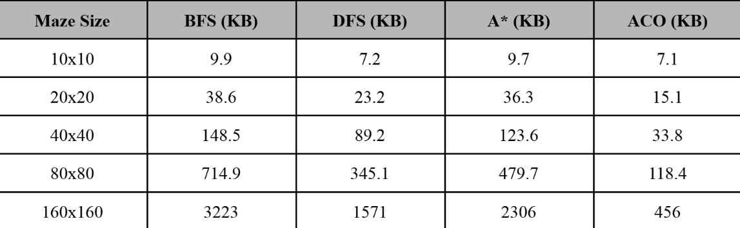
Peak Memory Usage vs Maze Size
Here we can see a distinct difference between the usage of memory across all models

Slide 10
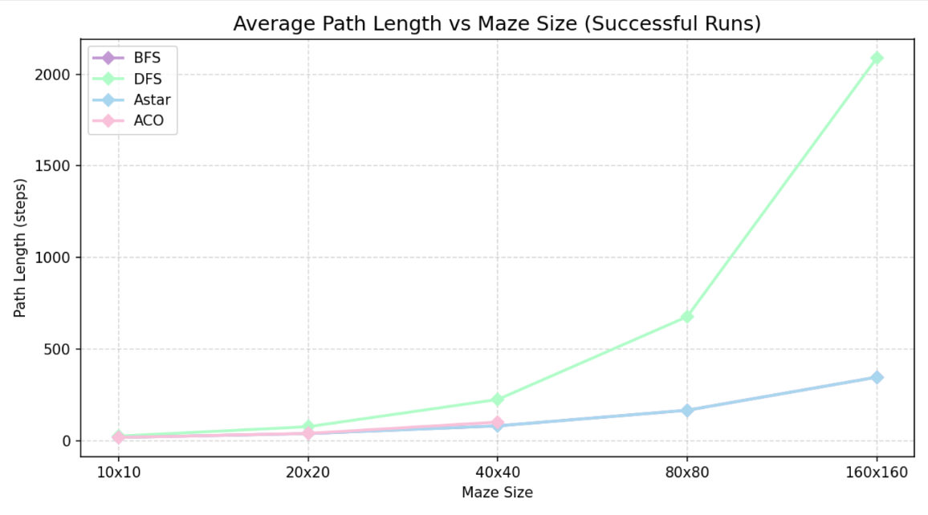
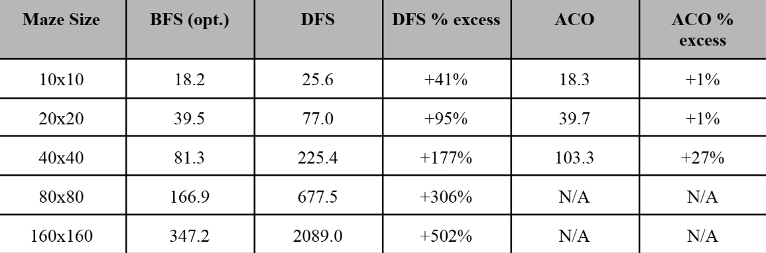
Path Length vs Maze Size
Interestingly both path lengths are equal between both BFS and A*, this confirms that the Manhattan distance heuristic is admissible and consistent.

Slide 11
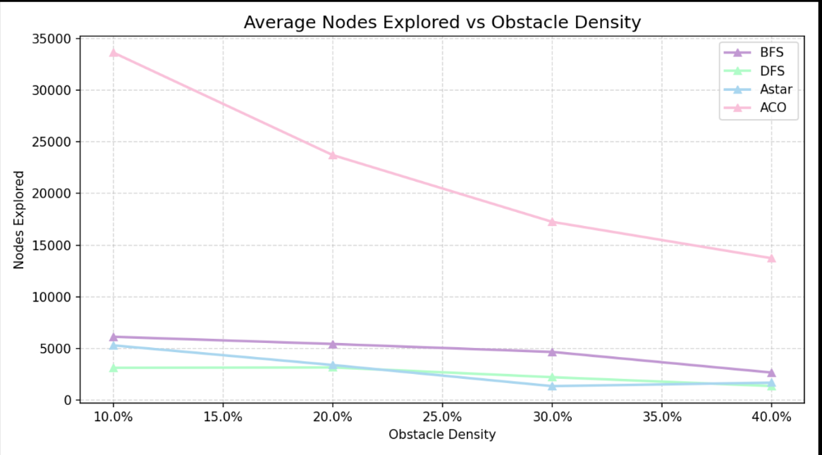
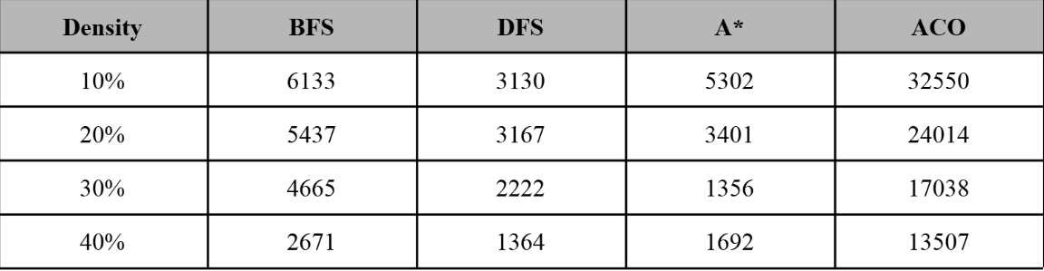
Nodes Explored vs Obstacle Density
For DFS, BFS, and A* nodes explored decrease as obstacle density increases because more walls reduce the number of reachable cells

Slide 12
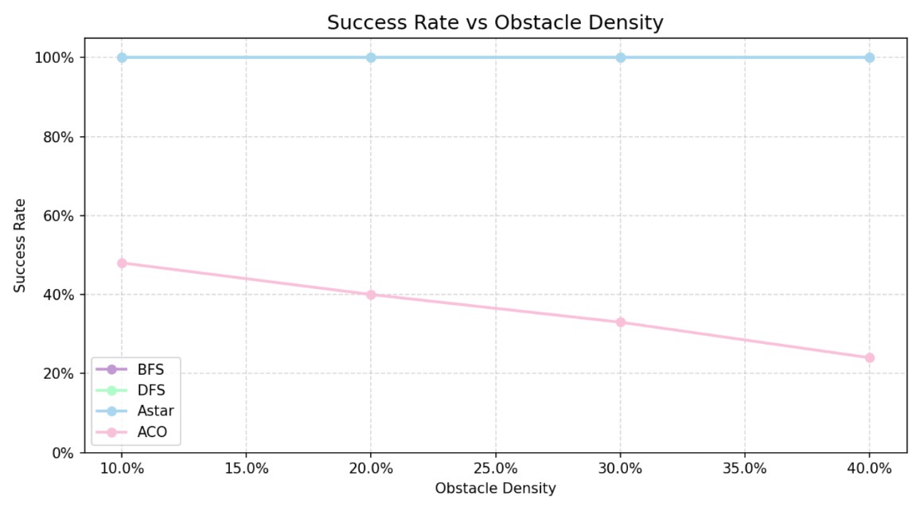
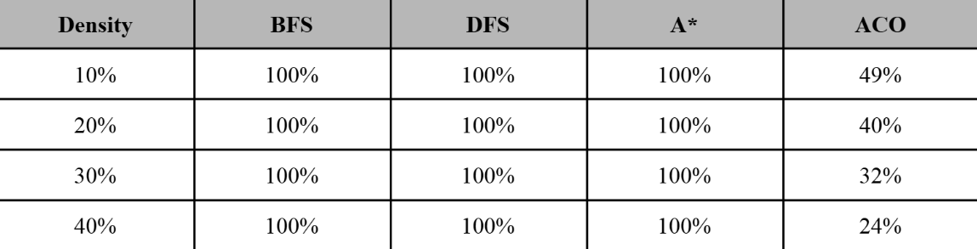
Success Rate vs Obstacle Density
BFS, DFS, and A* achieve 100% success on all solvable mazes, as expected - these algorithms are complete for finite graphs.

Slide 13
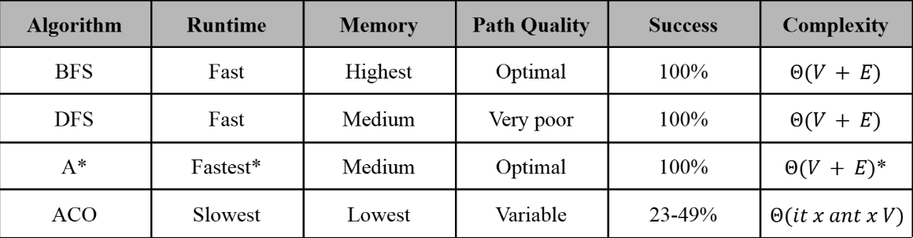
Trade-off
As seen from the chart, BFS dominates every category proving why its the benchmark for this project

